Slide 1

$ cat workshop.md
CITS1003 Project
in Sem 1 2026
Background Knowledge
topics: Cryptography, Forensics

Slide 2


$ whoami
Fudong Qin
Software Engineer@ DUSTAC | Lab Facilitator@ UWA
education: Master of IT — The University of Western Australia
facilitated: CITS1003, CITS1401, CITS5503, CITS5504, CITS5505, CITS5506, CITS5206
awards: 4x Commendation Letters for outstanding performance as a Facilitator at CSSE
website: fudong.dev
Web Development
DevOps
Cloud Computing
IoT
Full Stack

Slide 3
01
Cryptography
Encoding, encryption, compression, and randomness

Slide 4

$ cat crypto/objectives.md
Learning Objectives
> Recognise and decode common encoding schemes (Base64, Hex, URL)
> Use CyberChef to chain multiple decode/decompress operations
> Understand how AES block cipher works, especially ECB mode
> Explain why PRNGs are predictable given the seed
> Decode and inspect Flask session cookies

Slide 5
$ cat crypto/encoding-intro.md
What Is Encoding?
Encoding transforms data into a different format for transport or storage. It is NOT security:
No key needed -- anyone can encode and decode. The algorithm is public
NOT security -- encoding is a format, not protection. Never use Base64 to "hide" passwords
URLs encode spaces as %20 -- because URLs cannot contain literal spaces
Email uses Base64 -- because email (SMTP) is text-only, so binary attachments must be converted
Everyday analogy -- Morse code is encoding: dots and dashes represent letters
Hello --> encode --> SGVsbG8=
SGVsbG8= --> decode --> Hello
Analogy: Like converting Celsius to Fahrenheit -- different scale, same temperature. Anyone can convert back.
Think of encoding like translating English to Morse code — anyone who knows Morse can read it. No secret needed.

Slide 6
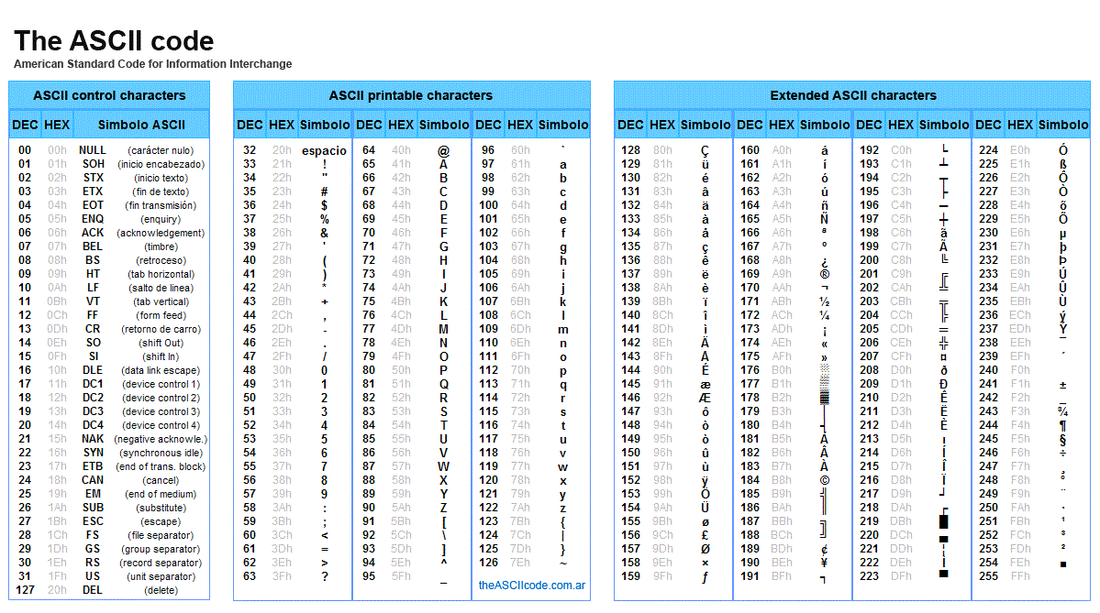
$ man ascii
ASCII — The Foundation
ASCII maps each character to a number (0–127). The basis of how computers represent text.
Char | Dec | Hex | Char | Dec | Hex
A | 65 | 41 | a | 97 | 61
B | 66 | 42 | 0 | 48 | 30
Z | 90 | 5A | (space) | 32 | 20
Full ASCII Table (DEC / HEX / Symbol)
> Hex (hexadecimal) = base-16 number system using 0-9 and A-F
> Every text file = a sequence of ASCII byte values
> Hex editors show bytes — ASCII table helps you read them

Slide 7
$ cat crypto/encoding-formats.md
Recognising Encoding Formats
Format | Example | How to Recognise
ASCII | 72 101 108 108 111 | Decimal numbers 0-127
Base64 | SGVsbG8gV29ybGQ= | Often ends with = or ==, uses A-Z a-z 0-9 +/
Hex | 48 65 6c 6c 6f | Only 0-9 and a-f (case-insensitive)
URL | hello%20world%21 | Contains %XX patterns
How to tell these apart: Check the character set. If only 0-9 and a-f, it is hex. Mixed case with = padding = Base64. % followed by two hex digits = URL encoding.
Note: A hex dump (e.g. 00000000: 4865 6c6c) is a way to VIEW binary data, not an encoding format itself.
Decoding strategy: Look at the character set -> identify encoding -> decode. If output still looks encoded, repeat!

Slide 8
$ cat crypto/encoding-formats.md
Common Encoding Formats — Examples
# Base64
Input: Hello World
Output: SGVsbG8gV29ybGQ=
# Hexadecimal
Input: Hello
Output: 48656c6c6f
# URL Encoding
Input: hello world!
Output: hello%20world%21
# Hex Dump (xxd output)
00000000 48 65 6c 6c 6f
|Hello|

Slide 9
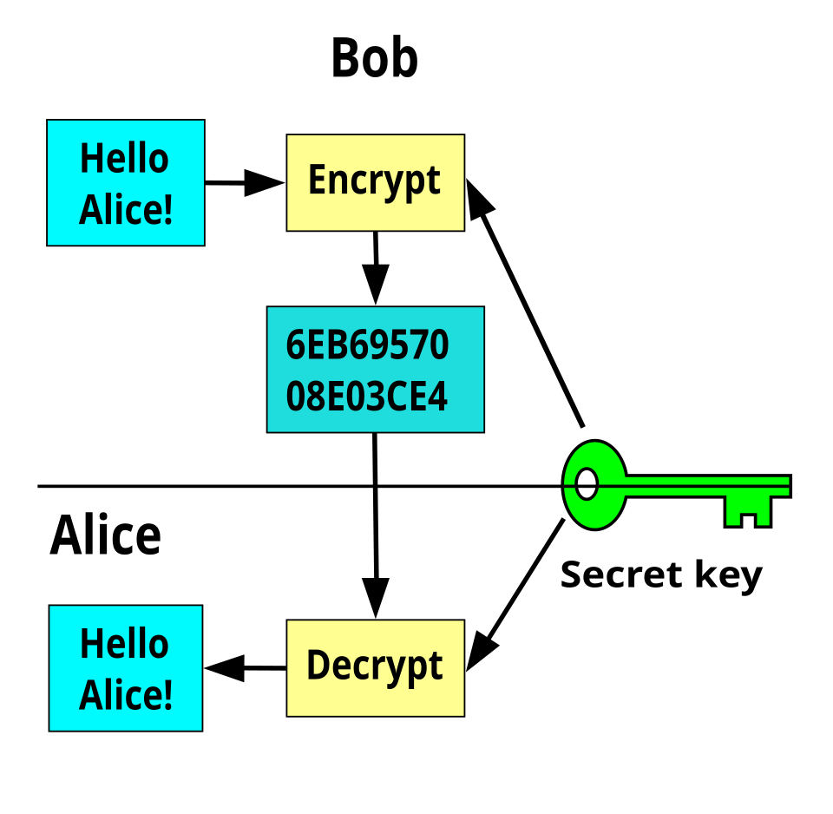
$ cat crypto/encryption-intro.md
What Is Encryption?
Encryption scrambles data so only someone with the key can read it
Like a locked safe -- without the key, the data is just noise
Symmetric encryption: same key encrypts and decrypts (AES). Asymmetric: two keys (RSA)
AES is the most common -- divides data into 16-byte blocks
Key lengths: AES-128 (16 bytes), AES-256 (32 bytes). Longer = harder to brute-force
Modes: ECB, CTR, CBC determine how blocks relate to each other
CTR mode -- combines a nonce with an incrementing counter. Each block is XORed with a unique value
Unlike encoding, encryption CANNOT be reversed without the secret key.
Symmetric Key Encryption (Wikipedia)

Slide 10
$ diff encoding encryption
Encoding vs. Encryption
 | Encoding | Encryption
Purpose | Change data format | Protect data
Key needed? | No | Yes
Reversible? | Yes -- by design | Yes -- with key
Security? | None | Yes
Examples | ASCII, Base64, Hex | AES, RSA, ChaCha20
Analogy | Translating a language | Locking in a safe
Common mistake: "It looks like random characters, so it must be encrypted." Not always! Base64 looks random but anyone can decode it.

Slide 11
$ cat crypto/compression.md
What Is Compression?
Compression reduces data size by removing redundancy — like zipping a file
> Compression makes data smaller, but doesn't hide it (not encryption)
> Common formats: gzip, zlib, zip — you've used zip files before!
> Data is often compressed THEN encoded for transmission
> To reverse: decode first, then decompress (reverse order)
In CTFs, data can be layered: Original → compress → encode → encode again. You peel layers off in reverse.

Slide 12
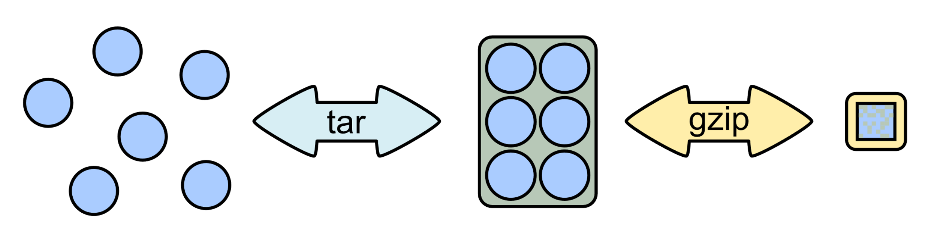
$ cat crypto/compression.md
Compression & Layered Encoding
Compression makes data smaller by removing redundancy. Common formats: gzip, zip, bzip2. Layers stack up -- unwrap in reverse:
Encoding (wrapping layers)
Original
->
gzip
->
URL encode
->
Base64
->
Final output
Decoding (unwrapping in reverse)
Final output
->
From Base64
->
URL decode
->
gunzip
->
Original
tar.gz: archive (tar) + compress (gzip) in one step
In CyberChef: Build a recipe by dragging operations in reverse order. Try "Detect File Type" or "Magic" to guess the next step.

Slide 13
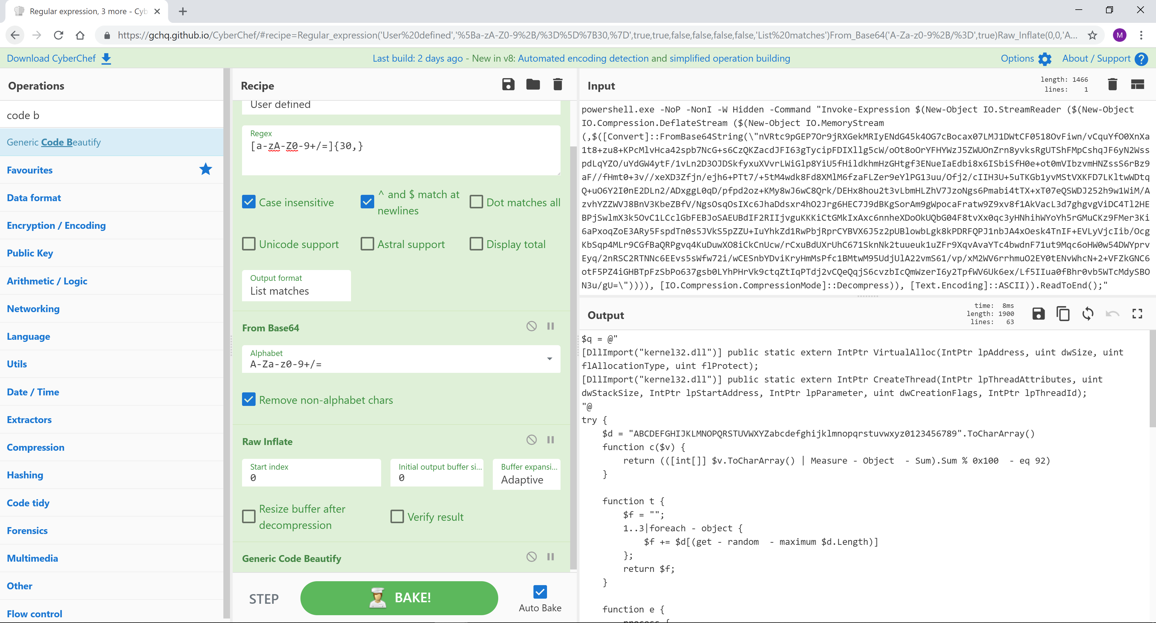
$ cat crypto/cyberchef.md
CyberChef — Chaining Operations
CyberChef is an online tool that lets you chain decode/decompress operations
Original
→
gzip
→
URL encode
→
Hex encode
→
Base64
CyberChef — "Swiss Army knife" for data transforms
> Input → paste your data
> Recipe → drag operations from the left panel
> Output → see the transformed result
Tip: If output looks like gibberish, use "Detect File Type".

Slide 14
$ open cyberchef.io # common recipes
CyberChef -- Common Recipes
Here are the recipes you will use most often in CTF challenges:
Recipe | When to Use
From Base64 | Data with A-Z, a-z, 0-9, +, /, ending in = or ==
From Hex | Data with only 0-9 and A-F characters
URL Decode | Data with %XX patterns (e.g. %20 for space)
Gunzip / Raw Inflate | After decoding if output looks like random binary
Magic | When you have no idea what the encoding is -- let CyberChef guess
# Try this double-encoded challenge:
U0dWc2JHOGdWMjl5YkdRaA==
# Step 1: From Base64 -> SGVsbG8gV29ybGQh
# Step 2: From Base64 again -> Hello World!
Pro tip: You can chain multiple operations in a single recipe. CyberChef runs them top-to-bottom, so order matters!

Slide 15



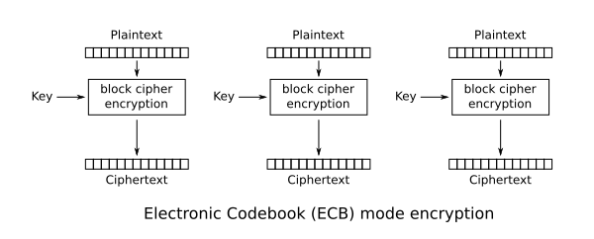
$ python3 crypto/aes_ecb_demo.py
AES Encryption — ECB Mode
ECB = each 16-byte block encrypted independently. Identical blocks → identical ciphertext.
> ECB leaks patterns — still see the penguin!
> Can encrypt blocks separately & concatenate
> Can rearrange ciphertext blocks
→
→
Original
ECB mode
CTR mode
ECB mode: same key applied independently to each block
Key insight: ECB encrypts blocks independently — a weakness you can exploit.

Slide 16
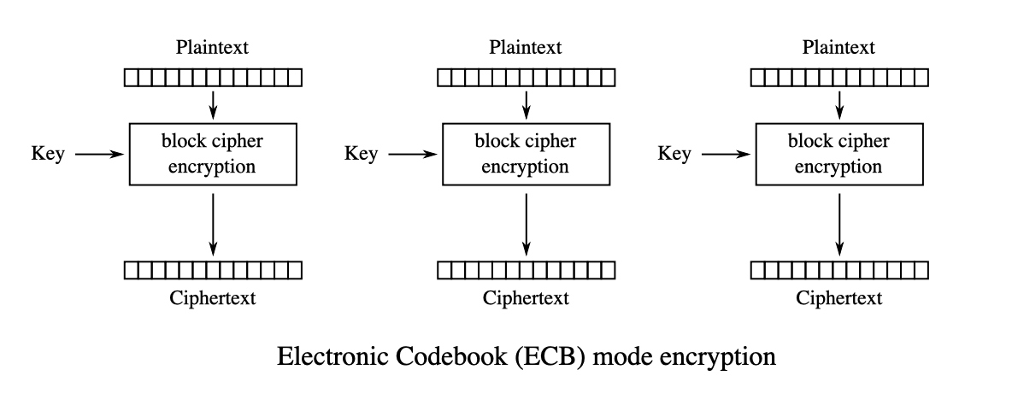
$ cat crypto/aes-ecb-blocks.md
AES — ECB Mode (Electronic Codebook)
ECB splits plaintext into 16-byte blocks, then encrypts each block independently with the same key
> AES is a block cipher — it can only encrypt exactly 16 bytes (128 bits) at a time
> Longer data is split into 16-byte blocks — each block is encrypted separately with the same key
> Identical plaintext blocks → identical ciphertext blocks — patterns are preserved!
ECB mode encryption (Wikipedia)
Why ECB is weak: same plaintext block always produces the same ciphertext block, so repeating patterns in data are visible in the encrypted output.

Slide 17
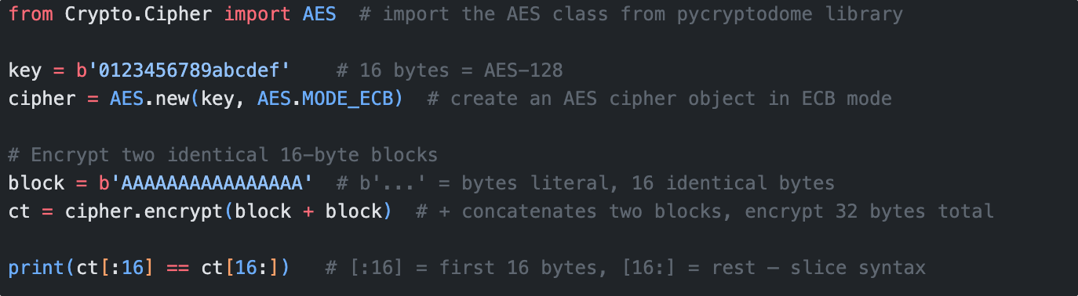
$ cat crypto/ecb_demo.py
AES ECB — Demo
Try it: Encrypt blocks separately, concatenate, then decrypt — you get both blocks back.

Slide 18

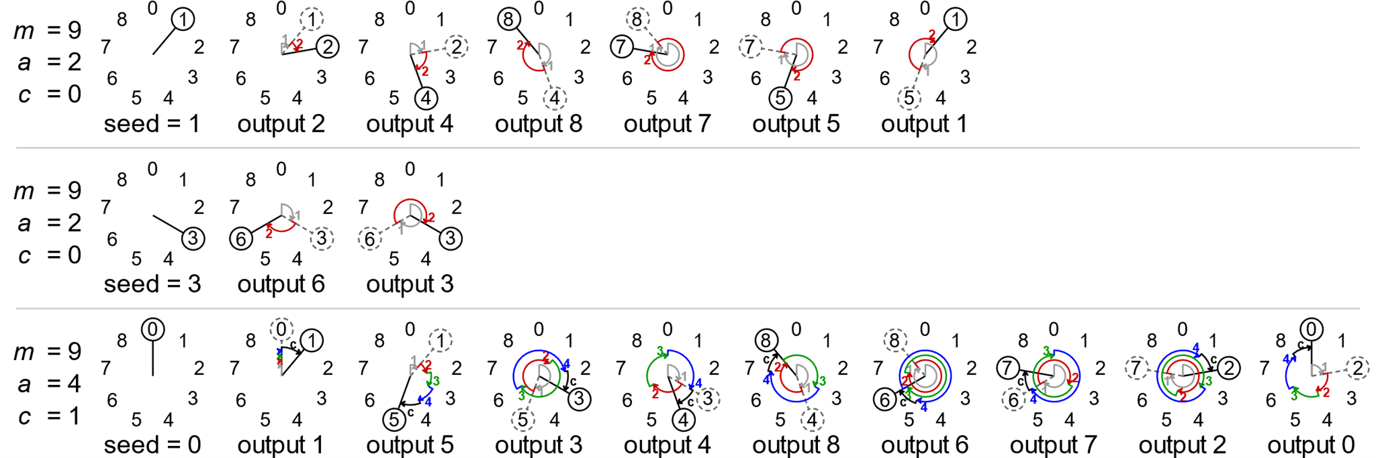
$ cat crypto/prng-concept.md
Random Numbers & Seeds
Standard library random functions use PRNGs -- deterministic, not truly random. Same seed = same sequence:
PRNG -- like a recipe: same ingredients (seed) always produce the same dish (sequence)
Seed -- the starting value that determines the entire output sequence
Same seed -> same sequence, always, on every machine
True random uses physical sources (radioactive decay, mouse movements) -- Python's os.urandom()
Time-based seeds -- if you know WHEN the program ran, you can reproduce the output
Seed: 42 -> PRNG -> 0,0,1,0,0...
Seed: 42 -> PRNG -> 0,0,1,0,0...
Seed: 99 -> PRNG -> 1,1,0,1,1...
Linear congruential generator pattern

Slide 19
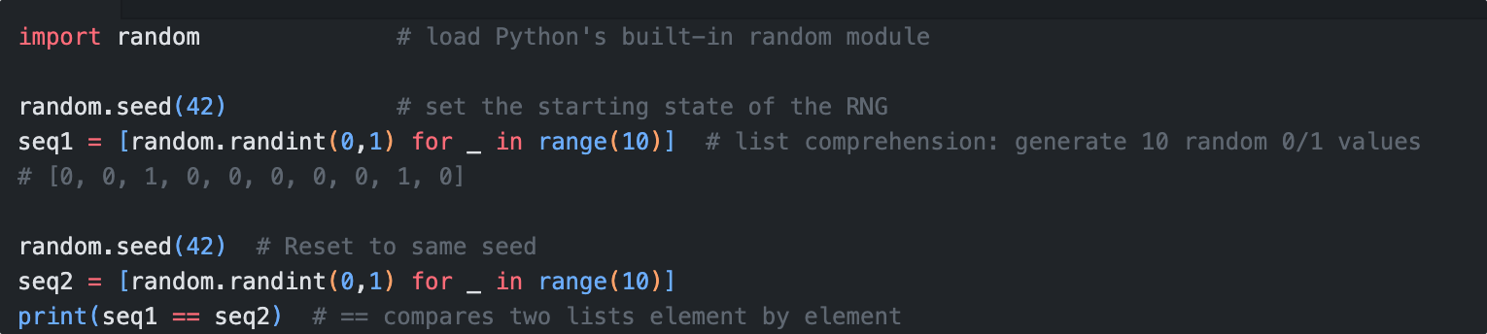
$ python3 crypto/prng_demo.py
PRNGs & Seeds
Computers use Pseudorandom Number Generators — deterministic, not truly random.
Key insight: Same seed → same sequence every time. Know the seed, predict every 'random' output.

Slide 20

$ cat crypto/web-basics.md
Web Basics — Frontend & Backend
Before Flask cookies, let's understand how web apps work
> Frontend (Client): HTML, CSS, JS — runs in your browser
> Backend (Server): processes requests, talks to databases
> HTTP: Browser sends request → Server responds
> Flask = a Python framework for building backends
Client-Server Model (Wikipedia)
Web apps are stateless — they use cookies and sessions to 'remember' who you are between requests.

Slide 21

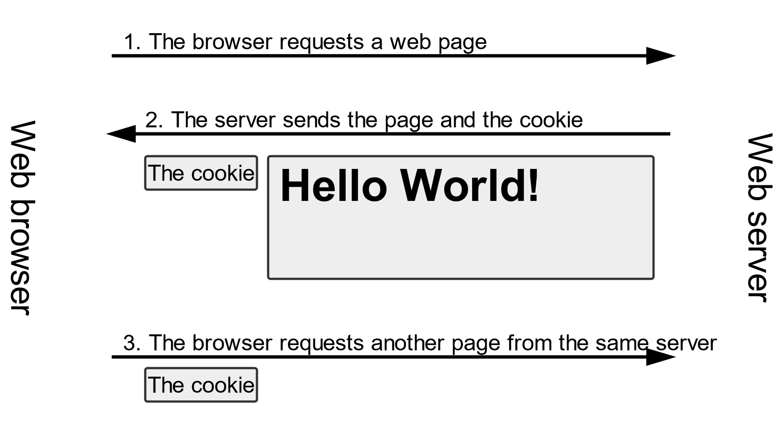
$ cat crypto/cookies.md
Cookies & Sessions
To solve the "stateless" problem, we use cookies -- small pieces of text stored in your browser:
Cookie -- small text stored in your browser. Sent automatically with every request to that site
Session -- server-side data linked to you via a session cookie (like a coat-check ticket)
Cookie attributes: Expires, Path, HttpOnly (JS cannot read it), Secure (HTTPS only)
First-party cookies come from the site you visit. Third-party cookies come from other domains (tracking/ads)
In your browser: Press F12 -> Application tab -> Cookies to see all cookies for the current site.
How cookies travel between browser and server

Slide 22
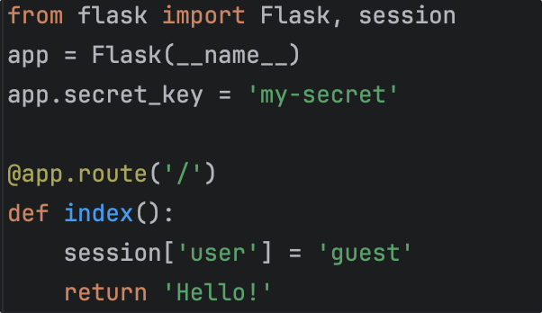

$ pip install flask
What is Flask?
Flask is a lightweight Python web framework -- build web apps with just a few lines:
Lightweight -- popular for small apps, APIs, and prototyping (used in many CTF challenges)
session -- Flask provides a built-in session object to store user data between requests
secret_key -- used to sign (not encrypt!) the session cookie to prevent tampering

Slide 23
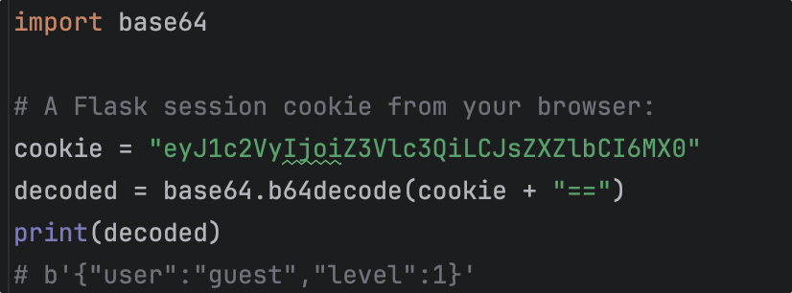
$ python3 crypto/flask_cookie.py
Flask Session Cookies
Flask's default session stores data in a client-side cookie, not on the server:
The cookie is Base64 encoded -- you can decode and read the contents!
Signed with HMAC (tamper-detection) but NOT encrypted -- the data is visible
Anyone can see what is in the session (user role, preferences) by simply Base64-decoding the cookie

Slide 24
02
Forensics
Metadata, hex analysis, and hidden data

Slide 25

$ cat forensics/objectives.md
Learning Objectives
> Extract and analyse metadata from image files using exiftool
> Use GPS coordinates from image metadata to perform geolocation
> Understand file format structures and magic bytes
> Use a hex editor (VS Code / ghex) to inspect and repair binary files
> Use steghide to extract hidden data from images

Slide 26
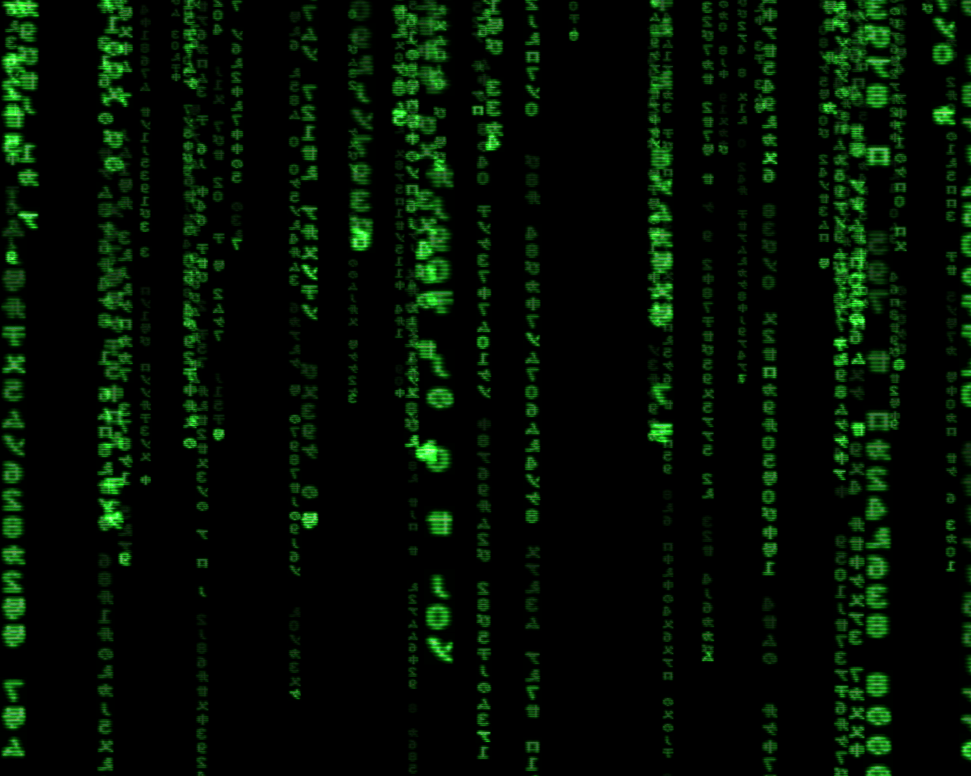
$ cat forensics/intro.md
What is Digital Forensics?
Law enforcement -- investigating cybercrime, recovering deleted evidence from phones and laptops
Incident response -- after a company is hacked, forensics determines how the attacker got in
Data recovery -- restoring accidentally deleted files or corrupted drives
Verify file integrity -- detect tampering, corruption, or forgery
Trace origins -- when/where/by whom was a file created?
Looking beyond the surface

Slide 27

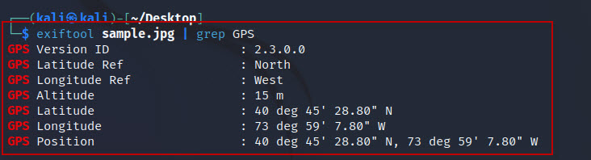
$ cat forensics/metadata-intro.md
What is Metadata?
Metadata is data about data. Like the label on a parcel -- it tells you about the contents without opening it:
A photo -- stores camera model, date, GPS location, aperture, shutter speed, software used to edit
A Word doc / PDF -- stores author name, edit history, creation date, software version
A music file -- stores artist, album, track number, genre, cover art
An email -- headers reveal sender's IP address, mail server path, timestamps at each hop
A web page -- HTTP response headers reveal server software (e.g. "Server: nginx/1.18")
Metadata revealed by exiftool
Why it matters: People often forget metadata exists. A "clean" photo may still reveal exactly where and when it was taken.

Slide 28
$ exiftool photo.jpg
EXIF Data & exiftool
EXIF (Exchangeable Image File Format) is the standard for photo metadata. Cameras embed dozens of fields:
$ exiftool suspicious_photo.jpg
Camera Model : iPhone 14 Pro
Date/Time : 2025:03:15 14:32:07
GPS Latitude : 31 deg 57' 50.51" S
GPS Longitude : 115 deg 51' 27.77" E
Image Size : 4032x3024
Software : Adobe Photoshop
GPS coordinates -- tells you exactly where the photo was taken
Software field -- reveals if the image was edited (Photoshop, GIMP, etc.)
Timestamps -- DateTimeOriginal (when taken) vs. ModifyDate (when last saved)
Useful flags: exiftool -a (all tags), -G (tag groups), -s (tag names)

Slide 29
$ cat forensics/gps.md
GPS Coordinates & Geolocation
EXIF stores GPS in DMS (Degrees, Minutes, Seconds). Maps need Decimal Degrees:
Format | Example
DMS | 31 deg 57' 50.51" S, 115 deg 51' 27.77" E
Decimal | -31.9640, 115.8577
# Formula: Decimal = Degrees + Minutes/60 + Seconds/3600
# Latitude: 31 deg 57' 50.51" S
Step 1: 31 + (57 / 60) + (50.51 / 3600)
Step 2: 31 + 0.9500 + 0.0140 = 31.9640
Step 3: Direction is S (South), so negate -> -31.9640
# Longitude: 115 deg 51' 27.77" E
Step 1: 115 + (51 / 60) + (27.77 / 3600)
Step 2: 115 + 0.8500 + 0.0077 = 115.8577
Step 3: Direction is E (East), so positive -> 115.8577

Slide 30
$ file mystery_file
How Computers Identify Files
File extensions (.pdf, .jpg) are just part of the filename -- they can be easily changed and are not reliable:
# Rename a PNG to .txt -- it is still a PNG inside!
$ mv photo.png photo.txt
$ file photo.txt
photo.txt: PNG image data, 800 x 600
# A ZIP file disguised as a .jpg:
$ file vacation.jpg
vacation.jpg: Zip archive data, at least v2.0 to extract
The file command reads the first few bytes -- the magic bytes (file signature) -- to determine the real type
Polyglot files -- files that are valid as multiple types simultaneously (e.g. both a valid PDF and a valid ZIP)
In forensics: Never trust file extensions. Always run file and check the magic bytes to know what a file really is.

Slide 31
$ xxd -l 16 mystery_file
Common Magic Bytes
File Type | Magic Bytes (Hex) | ASCII
PDF | 25 50 44 46 | %PDF
PNG | 89 50 4E 47 0D 0A 1A 0A | .PNG....
JPEG | FF D8 FF
GIF | 47 49 46 38 | GIF8
ZIP / DOCX / XLSX | 50 4B 03 04 | PK..
GZIP | 1F 8B
ELF (Linux binary) | 7F 45 4C 46 | .ELF
BMP | 42 4D | BM
What if magic bytes are wrong? If someone corrupts or removes them, the file command will not recognise the file. You may need to inspect bytes in a hex editor manually.
Connection: Magic bytes use hex notation -- each pair is one byte. For example, 25 50 44 46 is the ASCII string %PDF in hex.
Interesting fact: .docx and .xlsx files are actually ZIP archives! That is why they start with PK (Phil Katz, inventor of ZIP).

Slide 32
$ code --install-extension ms-vscode.hexeditor
Hex Editor — VS Code
View and edit raw binary content of any file
# Two columns: Hex values | ASCII representation
Offset Hex ASCII
00000000 25 50 44 46 2D 31 2E 34 0A 31 20 30 ... |%PDF-1.4.1 0 obj|
> VS Code: Install "Hex Editor" extension → Right-click → Open With → Hex Editor
> Works on Windows, Mac, and Linux — best choice for most students
> Linux alternative: ghex (sudo apt install ghex), available in your VM
How to repair a corrupted file:
> Open file → check first bytes → compare with magic bytes → edit to correct → Save

Slide 33
$ xxd mystery_file | head
Hex Editors -- Seeing Raw Bytes
A hex editor shows file contents as hex values + ASCII side by side:
Offset Hex values ASCII
00000000: 2550 4446 2d31 2e34 0a31 2030 206f 626a %PDF-1.4.1 0 obj
00000010: 0a3c 3c20 2f54 7970 6520 2f43 6174 .<< /Type /Cat
What you can do in a hex editor
Search for strings -- find hidden text, URLs, passwords, or flag formats buried in binary data
Compare files -- spot differences between an original and a modified version
Find patterns -- identify file boundaries (e.g. find a JPEG inside a PNG by looking for FF D8 FF)
Edit bytes -- fix corrupted magic bytes, patch binaries, or modify file headers
Tools: VS Code + Hex Editor extension (easiest), GHex (Linux GUI), xxd (command-line, built into most systems).

Slide 34

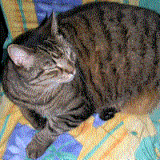
$ cat forensics/stego-intro.md
What is Steganography?
Encryption makes data unreadable. Steganography makes data invisible. The goal is to hide the existence of a message:
 | Encryption | Steganography
Hides | Content | Existence
Visible? | Yes (as noise) | No (looks normal)
Suspicious? | Yes | No
->
Tree (has hidden cat!)
Hidden cat extracted
Historical examples -- invisible ink (lemon juice), microdots, messages hidden in wax tablets
Image stego (LSB) -- changes the Least Significant Bit of each pixel. 200 vs 201 is invisible to the eye
Text stego -- zero-width characters, extra whitespace between words
Classic example from Wikipedia
Encryption makes data unreadable. Steganography makes data invisible. They can be combined!

Slide 35
$ steghide --help
steghide -- Stego Tool
steghide is the most common tool for hiding/extracting data in JPEG and BMP images:
# Step 1: Check if a file contains hidden data
$ steghide info -sf image.jpg
# Step 2: Try extracting with empty password first
$ steghide extract -sf image.jpg -p ""
# Step 3: If that fails, try with a guessed password
$ steghide extract -sf image.jpg -p "secret" -xf output.txt
Option | Meaning
info -sf | Show info about embedded data
extract -sf | Extract hidden data from file
-p | Passphrase (password)
-xf | Write extracted data to this file

Slide 36

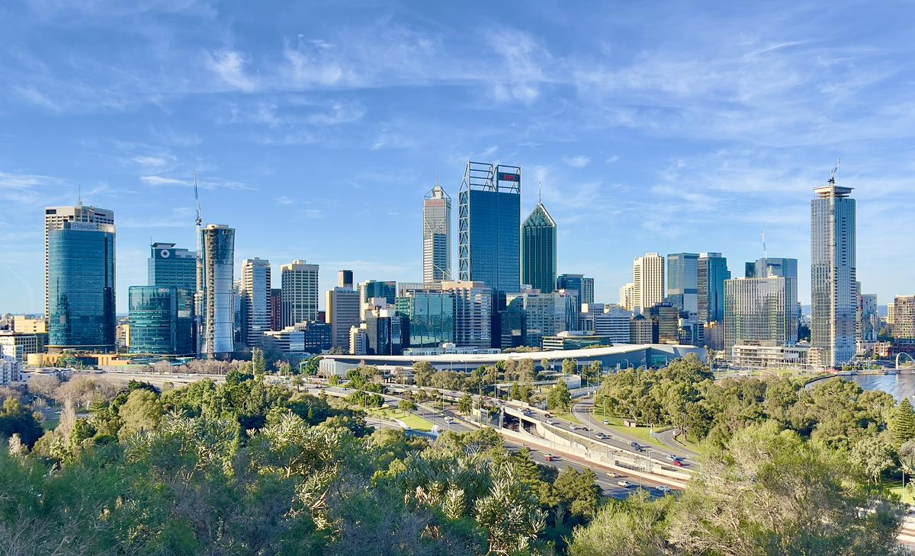




$ cat career/au-it-market.md
The Australian IT Job Market
Hottest directions (Hays & ACS 2026)
Cybersecurity -- biggest skills shortage in AU. Architects, pentesters, engineers in high demand
AI / Machine Learning -- fastest-growing job category. 80% of employers prefer AI-comfortable candidates
Cloud Engineering -- Azure & AWS migration continues. Cloud + Security is a strong combo
Software Development -- largest volume of jobs. Salesforce, Oracle, ServiceNow specialists in demand
Data Engineering -- building the data infrastructure that powers AI initiatives
Perth, WA -- fewer roles, but less competition
The reality
> Competitive -- junior/grad tier gets hundreds of applications per role
> What matters -- English > experience > tech >> GPA

Slide 37
$ cat career/advice-for-students.md
Advice from a Recent Graduate
Things that actually made a difference when job hunting:
Skills & Projects
Job Hunting
Build one real, deployed project -- not a todo app. A complete product with a real URL, full lifecycle
Learn the local tech stack -- in AU, backend is .NET/Azure; frontend React. CI/CD via GitHub Actions
Security skills are a differentiator -- understanding encryption, auth, and common vulns makes you stand out
Tailor every application -- match resume keywords to the job description. HR filters by keyword match
Networking > mass applying -- many AU roles filled through referrals. Attend meetups, connect on LinkedIn
Prepare for behavioural interviews -- AU companies care about team fit. Prepare 5 stories about collaboration
The honest truth: Finding your first IT job in AU is hard. But every day you invest in real skills and connections compounds. You only need one yes.

Slide 38
$ cat career/ai-impact.md
AI Is Changing Everything -- What It Means for You
AI engineering is now the fastest-growing job category in Australia (ACS 2026). The impact goes far beyond AI-specific roles:
Everyone uses AI now -- in many companies, every developer is a "prompt engineer." What value do YOU add on top of AI?
The new hiring bar -- 80% of employers prefer candidates comfortable with AI tools over experienced workers who aren't
But AI makes mistakes constantly -- it generates plausible-looking code that silently fails, gives confident but wrong security advice
The pattern in industry -- junior devs who blindly copy AI output ship bugs. Those who understand fundamentals use AI as a force multiplier

Slide 39
$ cat career/fundamentals.md
AI Is a Tool, Not a Replacement for Understanding
AI makes fundamentals more important, not less:
Without fundamentals
With fundamentals
x AI gives you AES code -> you don't know it's using ECB mode -> data leaks patterns
o You use AI to write faster, then verify it's correct because you understand how encryption works
x AI says "this file is safe" -> you can't check magic bytes -> you miss a disguised executable
o You spot AI's mistakes -- wrong encoding, insecure defaults, broken logic -- before they ship
x AI generates a Flask app -> you don't understand session signing -> cookies are forgeable
o You ask AI precise, targeted questions because you know the domain well enough
x You can't ask the right questions, can't verify answers, can't debug when things break
o You become the person the team relies on when AI-generated code fails in production
This is exactly what today's workshop is about. The concepts you're learning are the foundation that makes you irreplaceable -- with or without AI.

Slide 40
Enjoy the Project!
Have fun exploring — curiosity is your best tool.
● CITS1003 | workshop.slides | UTF-8

